Slide 1








WUI-Net workshop
From research to decision making for fire risk mitigation at WUI
Side event of the 6th International Conference on Fire Behavior and Fuel,
29th of April 2019, Marseille, France
In the framework of the WUI-Net Inter-Carnot national project 2017-2019

Slide 2
WUI-NET background
Initialy an Horizon 2020 proposal (WUIFires-Net 2015 ) for the setup of an European Network
"From research to decision…"
Several European Institutions initially involved : ADAI (P), PAU COSTA - METEOGrid (E), CNR-IBIMET (I), Thessaloniki Univ (G),…

Slide 3
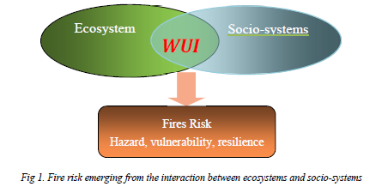
Why a focus on WUI
Context: emerging risk from the interaction between fuel ecosystem and social systems
Climate change X LULCC (urban spread, change in fuel ecosystems…)

Slide 4
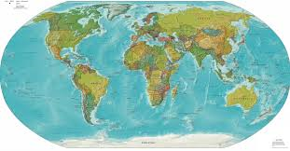





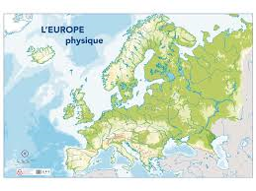
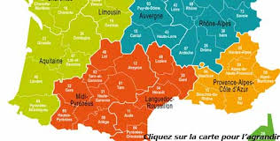







To enlarge the point of view
Ecosystems
Social systems
Knowledge
needs
WUI-Net
Research questions
Decision making
Management
Prevention
Firefighting…
Research,
knowledge
production
Transfer, decision
support systems
Models
Fire

Slide 5
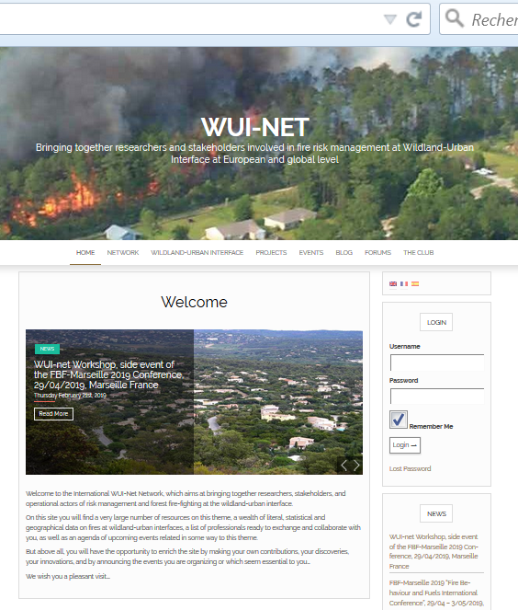
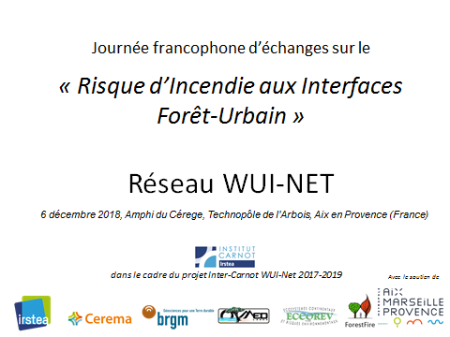
Previous WUI-Net workshop
French speaking workshop
the 6th of December 2018, Aix en Provence, F
https://wui-net.irstea.fr/
Michele Salis, CNR-IBIMET, Sassari, It.
Fantina Tedim, University of Porto (P)
Antonis Mantzavelas, Omikron, G.
Yvon Duché (ONF), Michel Bacou (CEREMA), Baptiste Vignerot (BRGM),
Ondine Le Fur, Julien Langumier (DDTM13)

Slide 6
PROGRAM
Organized around 4 presentations
Raphaele Blanchi/Justuin Leonard (CSIRO, Australia): The Australian case
Chris Dicus (Cal Poly University, USA): The Californian and US case
Mikele Salis (CNR-IBIMET, Sassari, Italy): Experiences in Sardinia
Michel Bacou (CEREMA, France): State information to citizen in France

Slide 7
PROGRAM (2nd part)
Proposed working groups
Land management and planning for risk mitigation at WUI
Firefighting, defense of values and anthropogenic vulnerabilities at WUI
WUI fuel, ornamental species, fire ecology and fire simulation at WUI
Missions (if accepted) :
to compare the relative contextual (national) situations regarding fire risk management at WUI
to identify some key research questions required by decision makers
to propose solutions for a better transfer from research to decision…

